Slide 1
PCV Modeling Update 02/2017
Marc Lipsitch, PI and Francisco Cai, Programmer

Slide 2
Recap
PCV Modeling Update 02/2017
Fitness parameters of the model are fit using peri-PCV7 (2001) data.
Model reproduces peri-PCV7 serotype-specific prevalences.
Expected, since number of free parameters = number of observed quantities.
Model had trouble reproducing PCV7-era serotype-specific prevalences.
Not surprising, since there are 40 more quantities, but only 1 new parameter, vaccine efficacy.
4 of 6 vaccine-related types (VRTs) were consistently underestimated (19A, 23A, 23B, 6C).
In general, model could not accommodate changes to the fitness ordering of serotypes.
Serogroup cross-immunity and shortened colonizations led to mild improvements.
Details in Phase II Tasks 3 and 4 Report.

Slide 3
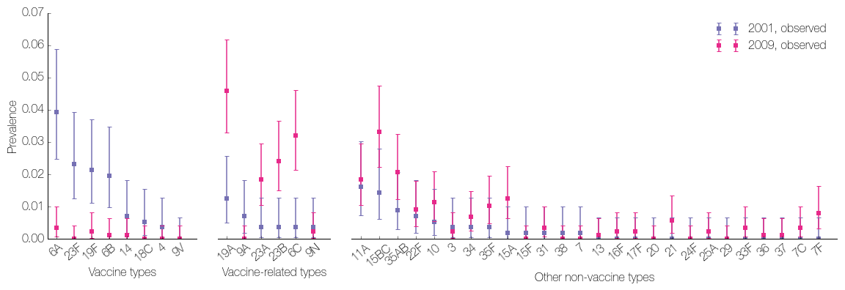
Next step
PCV Modeling Update 02/2017
Fit model using both peri-PCV and PCV-era data.
Peri-PCV data is more informative of vaccine types
PCV7-era data is more informative for VRTs and non-vaccine types (NVTs) that expanded after vaccine introduction...
...particularly for NVTs that were not sampled in 2001.

Slide 4
PCV Modeling Update 02/2017
Model fitting: Before
Goal: Maximize expected likelihood of parameters given 2001 data.
observed data
+
probabilistic model
stochastic simulation
simulated prevalences
likelihood estimate
parameters
Challenges: The likelihood…
… is a function of many (40) parameters
… has no closed form
→ cannot calculate gradient
… cannot even be calculated directly
→ we only have a noisy estimate of it by running a stochastic simulation, which takes time (1-2 min.)
}
Parameter space is big.
}
Difficult to determine which direction to explore next in parameter space.

Slide 5
PCV Modeling Update 02/2017
Model fitting: Shortcuts exploited
Goal: Maximize expected likelihood of parameters given 2001 data.
observed data
+
probabilistic model
stochastic simulation
simulated prevalences
likelihood estimate
parameters
Things we had going for us:
If the simulated prevalences matched the observed prevalences, this will maximize the likelihood.
→ Focus on finding parameters that reproduce the observed prevalences (green box).
Monotonic relationship between fitness rank and prevalence.
→ Based on our current simulated prevalence, we know how to adjust the fitness rank.
Adjusting a serotype’s fitness rank does not affect prevalences of other serotypes excessively.
→ Fitness parameters can be fit in parallel.

Slide 6
PCV Modeling Update 02/2017
Model Fitting: Now
Goal: Maximize expected likelihood of parameters given 2001 and 2009 data.
observed data +
probabilistic model
stochastic simulation
simulated 2001 prevalences
likelihood estimate
parameters
simulated 2009 prevalences
Things we used to have going for us (now with complications):
If the simulated prevalences matched the observed prevalences, this will maximize the likelihood.
→ Focus on finding parameters that reproduce the observed prevalences.
The simulated prevalences now have to match the observed data at two time points.
Monotonic relationship between fitness rank and prevalence.
→ Based on our current simulated prevalence, we know how to adjust the fitness rank.
We now adjust one rank and hope it reproduces the observed prevalence at two time points.
Adjusting a serotype’s fitness rank does not affect prevalences of other serotypes excessively.
→ Fitness parameters can be fit in parallel.
Parameters to be fit now also include vaccine efficacy.

Slide 7

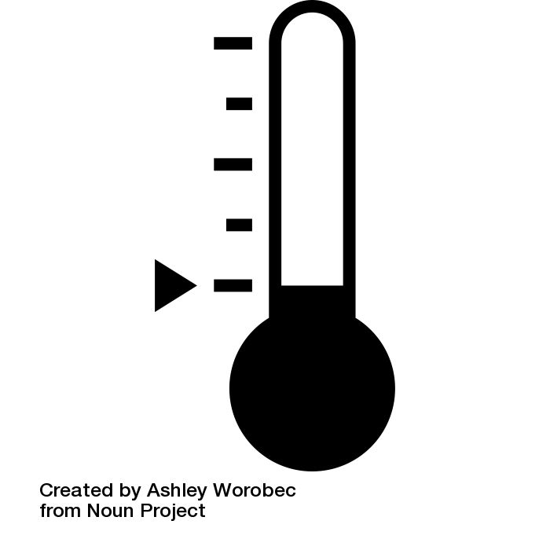
PCV Modeling Update 02/2017
Analogy
Room 2001
Before:
Target
Raise thermostat a little bit.
Room 2001
Target
Now:
Less clear what to do.
Room 2009
Target
Icons: Ashley Worobec, Sarah Tan. Noun Project. thenounproject.com

Slide 8
PCV Modeling Update 02/2017
Initial plan
Challenges and how to address them:
Difficult to determine which direction to explore next in parameter space (no analytical gradient)
Simultaneous perturbation stochastic approximation
Simultaneously perturb all parameters to estimate all components of the gradient.
(n parameters requires only 2 simulations / iteration)
However, simulations may be too noisy… If so, will try increasing population size or averaging results from multiple simulations.
Parameter space is large.
Try fitting fitness ranks in parallel, i.e. adjust each fitness rank as if it only affected the terms in the log-likelihood involving its serotype.
Adjust the fitness ranks and the vaccine efficacy on alternate iterations.

Slide 9
PCV Modeling Update 02/2017
First milestone
Try to reproduce previous results, i.e. fit only peri-PCV7 data using new algorithm
As before, use absolute prevalence error, rather than log-likelihood, to quantify how well we are doing.

Slide 10
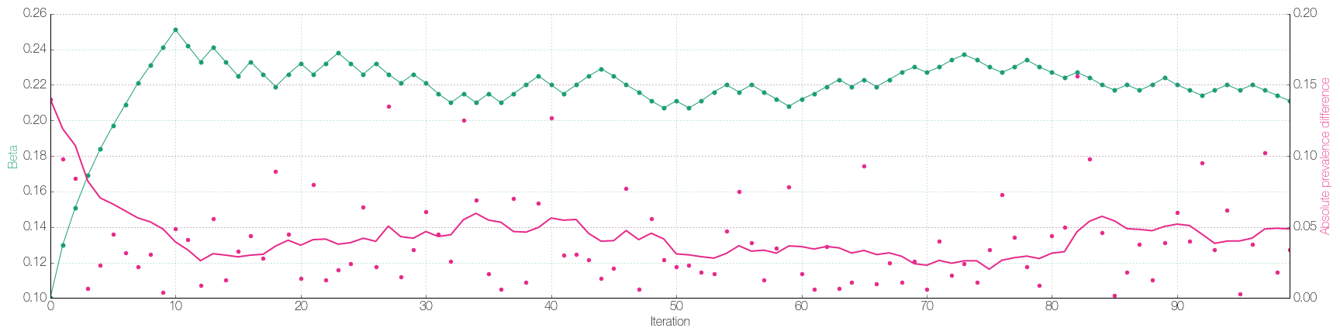
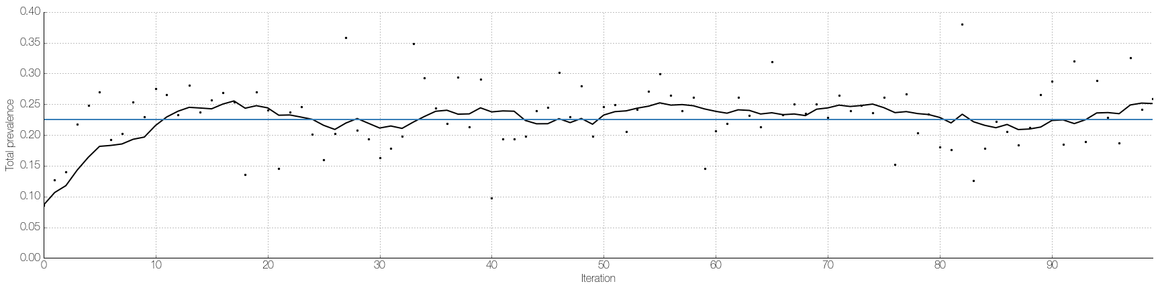
First test
PCV Modeling Update 02/2017

Slide 11
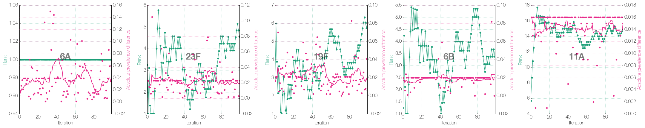
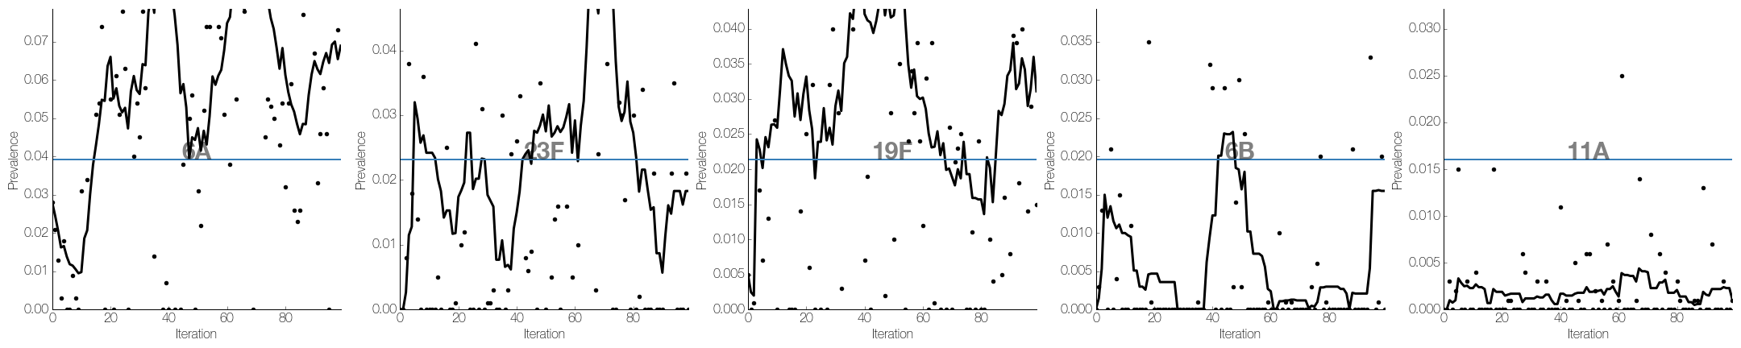
First test
PCV Modeling Update 02/2017

Slide 12
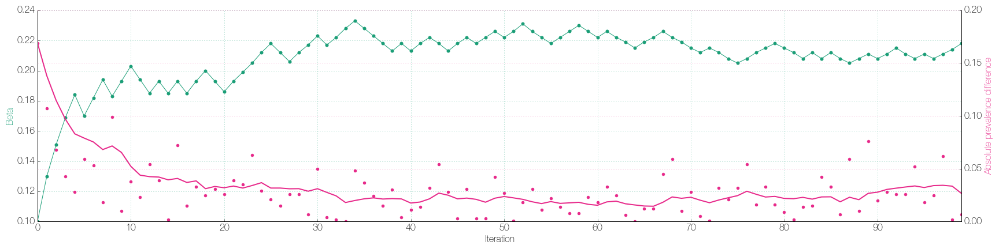
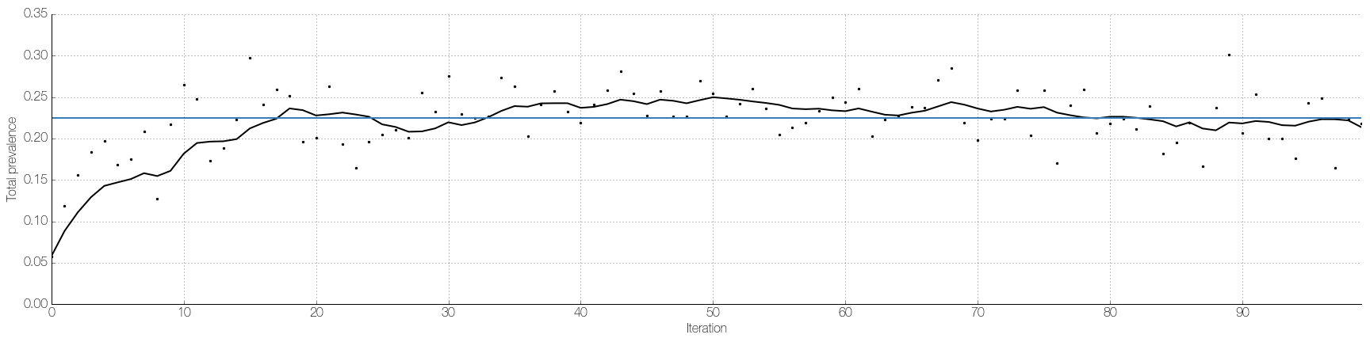
2.5x population size
PCV Modeling Update 02/2017

Slide 13
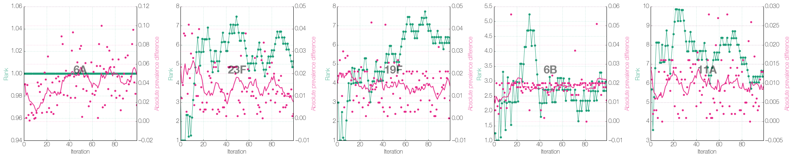
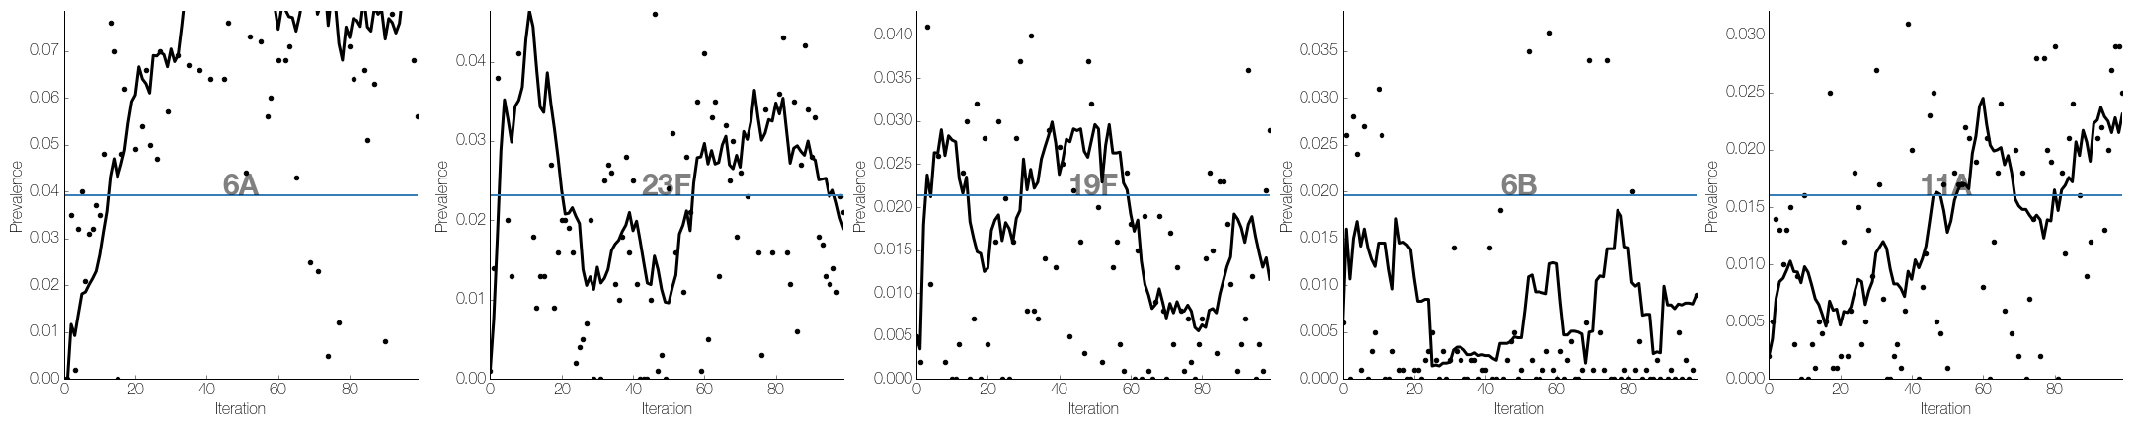
2.5x population size
PCV Modeling Update 02/2017

Slide 14
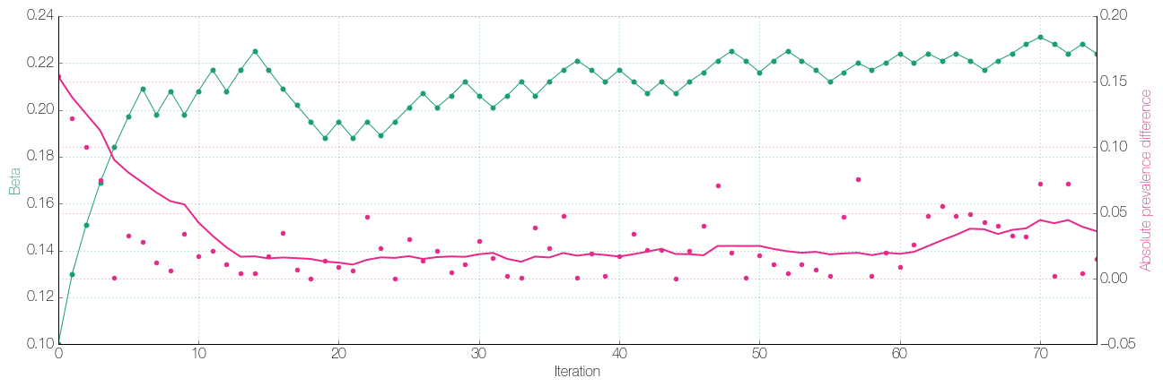
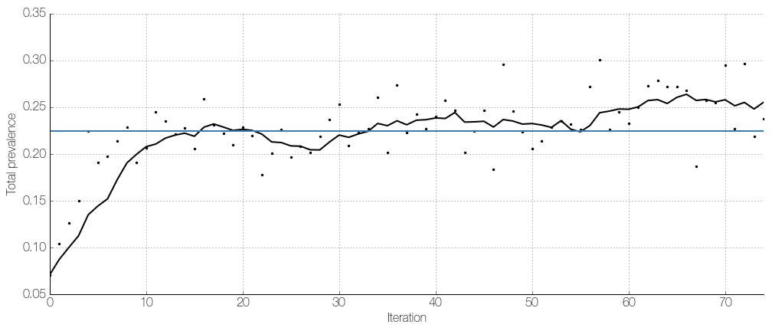
Averaging 5 simulations
PCV Modeling Update 02/2017

Slide 15
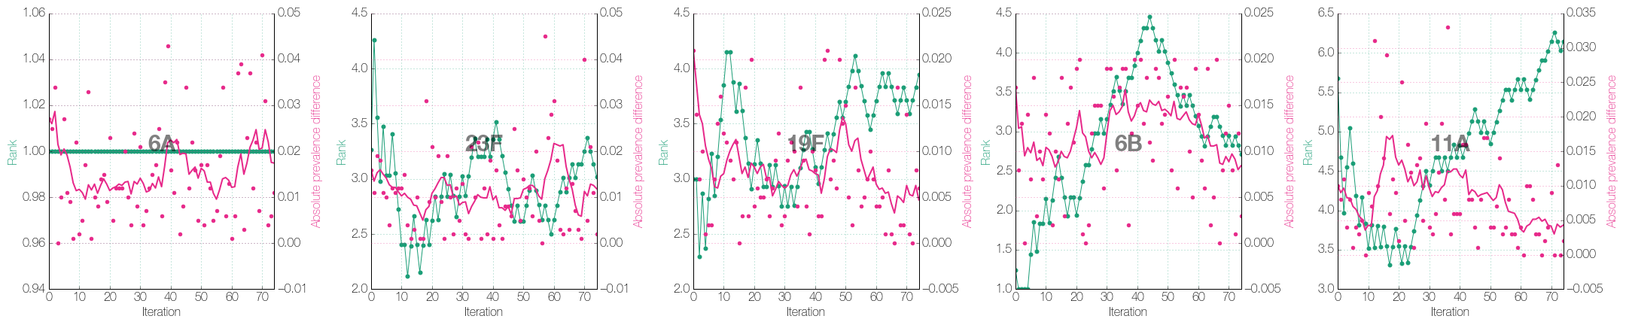
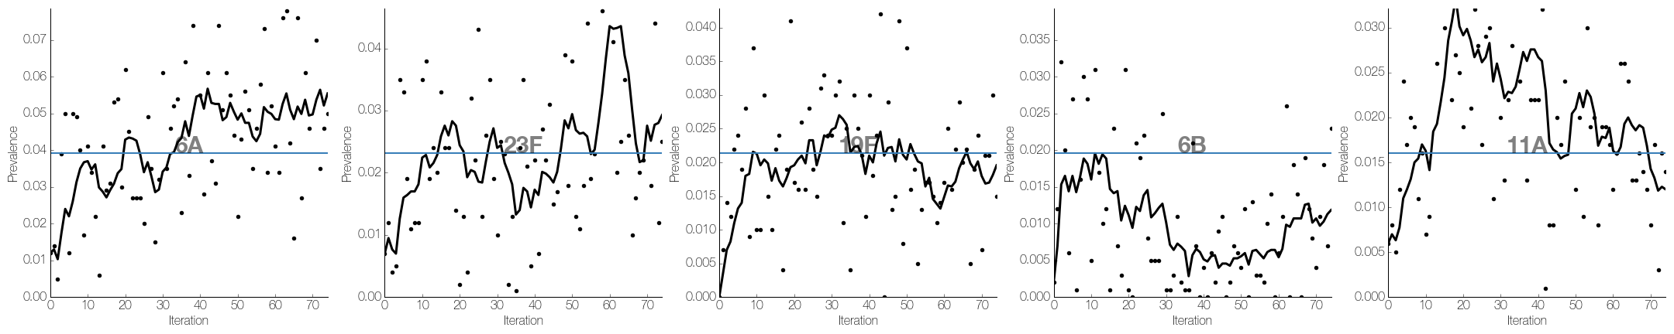
Averaging 5 simulations
PCV Modeling Update 02/2017

Slide 16
Next steps
PCV Modeling Update 02/2017
Immediate challenge seems to be stochastic noise affecting the fitting of individual serotype parameters.
How do we reduce noise, without increasing computational time too much?
Try simple ideas:
Use a combination of larger population sizes and averaging more simulations.
Instead of averaging, consider the distribution of results in each simulation set.
Perturb one parameter at a time for gradient estimation (runtime would increase dramatically, however).
Look for a more principled approach to statistical inference in individual-based models
Currently exploring this as a possible project, with Professor Pierre Jacob at Harvard (Statistics)

